Slide 1
Gradient-Based Optimization

Slide 2
Basics
Optimization refers to the task of either minimizing or maximizing some function f (x ) by altering x. We usually phrase most optimization problems in terms of minimizing f (x). Maximization may be accomplished via a minimization algorithm by minimizing −f(x).
The function we want to minimize or maximize is called the objective function or criterion. When we are minimizing it, we may also call it the cost function, loss function, or error function.
We often denote the value that minimizes or maximizes a function with superscript ∗. For example, we might say x∗ = arg min f(x).
Suppose we have a function y = f (x), where both x and y are real numbers. The derivative of this function is denoted as f’(x) or as dy/dx. The derivative f’(x) gives the slope of f (x) at the point x. In other words, it specifies how to scale a small change in the input in order to obtain the corresponding change in the output: f(x +ε ) ≈ f(x) +ε f’(x).
The derivative is therefore useful for minimizing a function because it tells us how to change x in order to make a small improvement in y.
For example, we know that f (x − ε sign(f’(x))) is less than f (x) for small enough ε. We can thus reduce f (x) by moving x in small steps with opposite sign of the derivative. This technique is called gradient descent

Slide 4
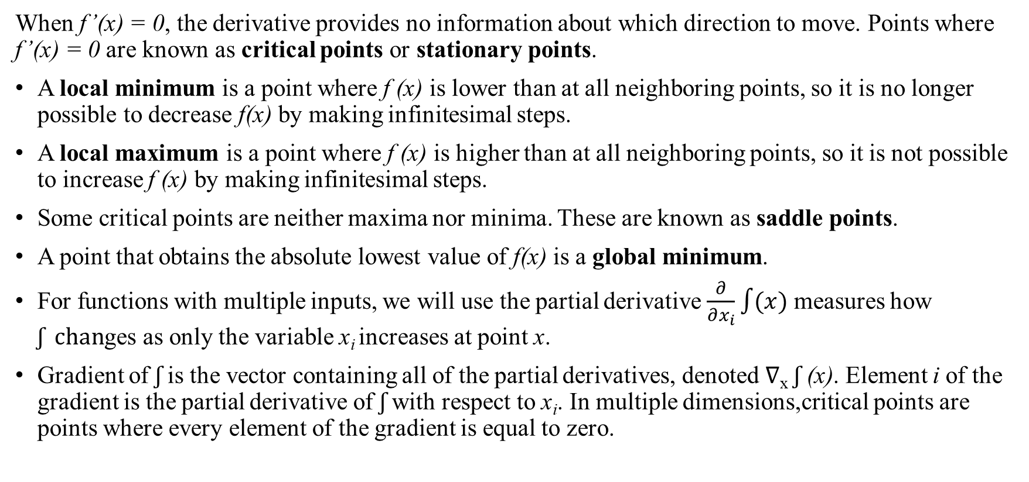
When f’(x) = 0, the derivative provides no information about which direction to move. Points where f’(x) = 0 are known as critical points or stationary points.
A local minimum is a point where f (x) is lower than at all neighboring points, so it is no longer possible to decrease f(x) by making infinitesimal steps.
A local maximum is a point where f (x) is higher than at all neighboring points, so it is not possible to increase f (x) by making infinitesimal steps.
Some critical points are neither maxima nor minima. These are known as saddle points.
A point that obtains the absolute lowest value of f(x) is a global minimum.
For functions with multiple inputs, we will use the partial derivative $\frac{∂}{∂x_{i}}\int{(x)}$ measures how $ʃ chan$ges as only the variable x_{i} increases at point x.
Gradient of $ʃ$ is the vector containing all of the partial derivatives, denoted ∇_{x} $ʃ$ (x). Element i of the gradient is the partial derivative of $ʃ$ with respect to x_{i}. In multiple dimensions,critical points are points where every element of the gradient is equal to zero.

Slide 5
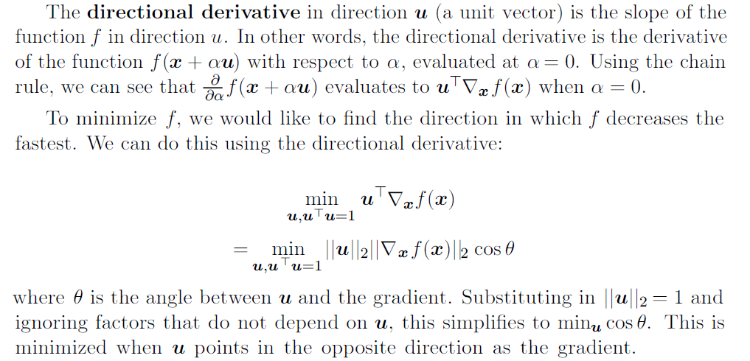

Slide 6
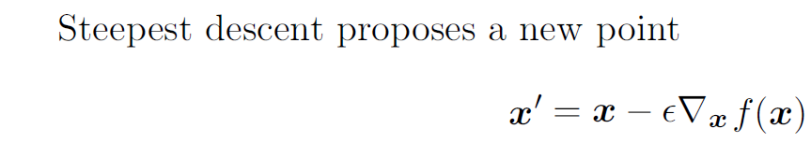
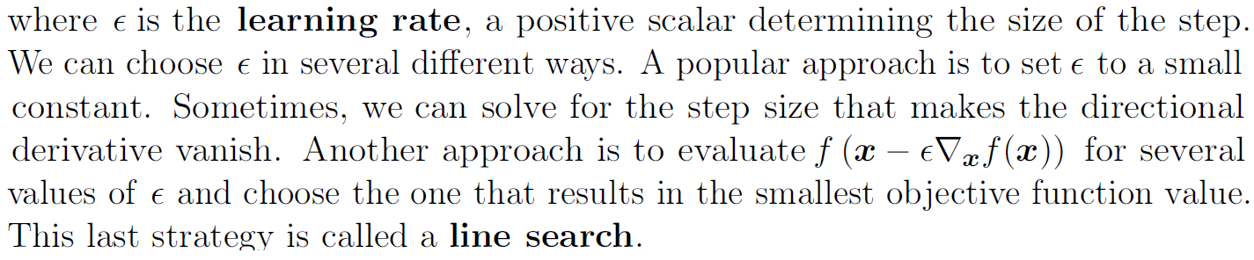
In other words, the gradient points directly uphill, and the negative gradient points directly downhill. We can decrease f by moving in the direction of the negative gradient. This is known as the method of steepest descent or gradient descent.

